Slide 1
2023 Annual Results
Adicon Holdings Limited
28 March 2024​​

Slide 2
Disclaimer
By attending the meeting where this presentation is made, or by reading the presentation materials, you agree to be bound by the following limitations:
These materials have been prepared by ADICON Holdings Limited (the "Company", and together with its subsidiaries, the "Group") solely for use at this presentation to investors for information purposes only, and have not been independently verified. No representations or warranties, express or implied, are made as to, and no reliance should be placed on, the accuracy, fairness completeness or correctness of the information or opinions presented or contained in these materials. Neither the Company, any member of the Group nor the Joint Sponsors, the Overall Coordinators, the Joint Global Coordinators, the Joint Lead Managers, the Joint Bookrunners, the Capital Market Intermediaries, the Underwriters nor any of their respective affiliates, controlling persons, directors, officers, employees, advisers or representatives shall have any liability whatsoever, as a result of negligence or otherwise, for any loss howsoever arising from any information or opinions presented or contained in these materials. The information or opinions presented or contained in these materials are subject to change without notice, and shall only be considered current as of the date hereof.
These materials contain statements that reflect the Company's beliefs or expectations about the future or future events as of the respective dates indicated therein ("forward-looking statements"). These forward-looking statements are based on a number of assumptions about the Group and other matters, such as the Group's operations, its future development plans, market (financial and otherwise) conditions, growth prospects, and are subject to known and unknown risks, uncertainties and other factors beyond the Group's control, and accordingly, actual results may differ materially from the results expressed or implied by these forward-looking statements. Each of the Company, members of the Group, the Joint Sponsors, the Overall Coordinators, the Joint Global Coordinators, the Joint Lead Managers, the Joint Bookrunners, the Capital Market Intermediaries and the Underwriters undertakes no obligation to update these forward-looking statements for events/or circumstances that occur subsequent to such dates.
These materials do not constitute or form part of and should not be construed as, a prospectus or other offering document or an offer or invitation to acquire, purchase or subscribe for any securities nor are they calculated to invite any such offer or invitation. In particular, these materials do not constitute and are not an offer to sell or a solicitation of any offer to buy securities in Hong Kong, the United States or anywhere else. No part of these materials shall form the basis of or be relied upon in connection with any contract or commitment whatsoever. The securities referred to herein have not been, and will not be, registered under the United States Securities Act of 1933, as amended (the "Securities Act") or securities laws of any state in the United States and may not be offered or sold in the United States without registration under the Securities Act, or except pursuant to an applicable exemption from, or in a transaction not subject to the registration requirements of the Securities Act and securities laws of any state in the United States. In Hong Kong, no securities of the Company may be offered to the public unless a prospectus in connection with the offering for sale or subscription of such securities has been authorized by The Stock Exchange of Hong Kong Limited for registration by the Registrar of Companies of Hong Kong, and has been so duly registered. Otherwise, without due registration, a prospectus must not be distributed, issued or circulated in Hong Kong. The offering circular of the Company in connection with the offering in the United States, Hong Kong or elsewhere will contain detailed information about the Group and its management as well as the financial statements of the Group. Nothing in these materials constitutes or forms any part of an offer of securities for sale in the United States, Hong Kong or any other jurisdiction, nor does it constitute or form any part of an invitation by or on behalf of the Company, any member of the Group or their respective affiliates or the Joint Sponsors, the Overall Coordinators, the Joint Global Coordinators, the Joint Lead Managers, the Joint Bookrunners, the Capital Market Intermediaries or the Underwriters or any of their respective affiliates, advisers or representatives to subscribe for or purchase any securities. Any decision to purchase securities in the offering should be made solely on the basis of the information contained in the offering circular in relation to the offering.
These materials are highly confidential, are being given solely for your information. The information or opinions contained herein and information presented orally or otherwise may not be copied, reproduced, redistributed, or otherwise disclosed, in whole or in part to any other person (whether within or outside your organization/firm) in any manner without the prior written consents of the Company, the Joint Sponsors, the Overall Coordinators, the Joint Global Coordinators, the Joint Lead Managers, the Joint Bookrunners, the Capital Market Intermediaries and the Underwriters. By attending this presentation, you are agreeing to maintain absolute confidentiality regarding this presentation and the information disclosed in these materials or presented orally or otherwise.
Neither these materials nor any part or copy of them may be taken or transmitted into or distributed in or into (by mail, facsimile, electronic or computer transmission or by any other means whatsoever), directly or indirectly, the United States (including its territories and possessions, any State of the United States and the District of Columbia). Any failure to comply with these restrictions may constitute a violation of United States securities laws. The distribution of these materials in other jurisdictions may be restricted by law, and persons into whose possession these materials come should inform themselves about, and observe, any such restrictions. The materials are not directed to, or intended for distribution to or use by, any person or entity that is a citizen or resident in any jurisdiction where such distribution or use would be contrary to law or regulation or which would require any registration or licensing within such jurisdiction.
By accepting this document, you are agreeing: (i) that you have read and agree to comply with the contents of this notice; (ii) to maintain absolute confidentiality regarding this presentation and the information disclosed in these materials or presented orally or otherwise; and (iii) you and any persons you represent are either (x) a "qualified institutional buyer" (within the meaning of Rule 144A under the Securities Act) or (y) outside the United States. This document is not intended for distribution to persons who are not professional investors (as defined in Schedule 1 to the Securities and Futures Ordinance (Chapter 571 of the Laws of Hong Kong)). Any failure to comply with these restrictions may constitute a violation of applicable securities laws.
Overview
2

Slide 3
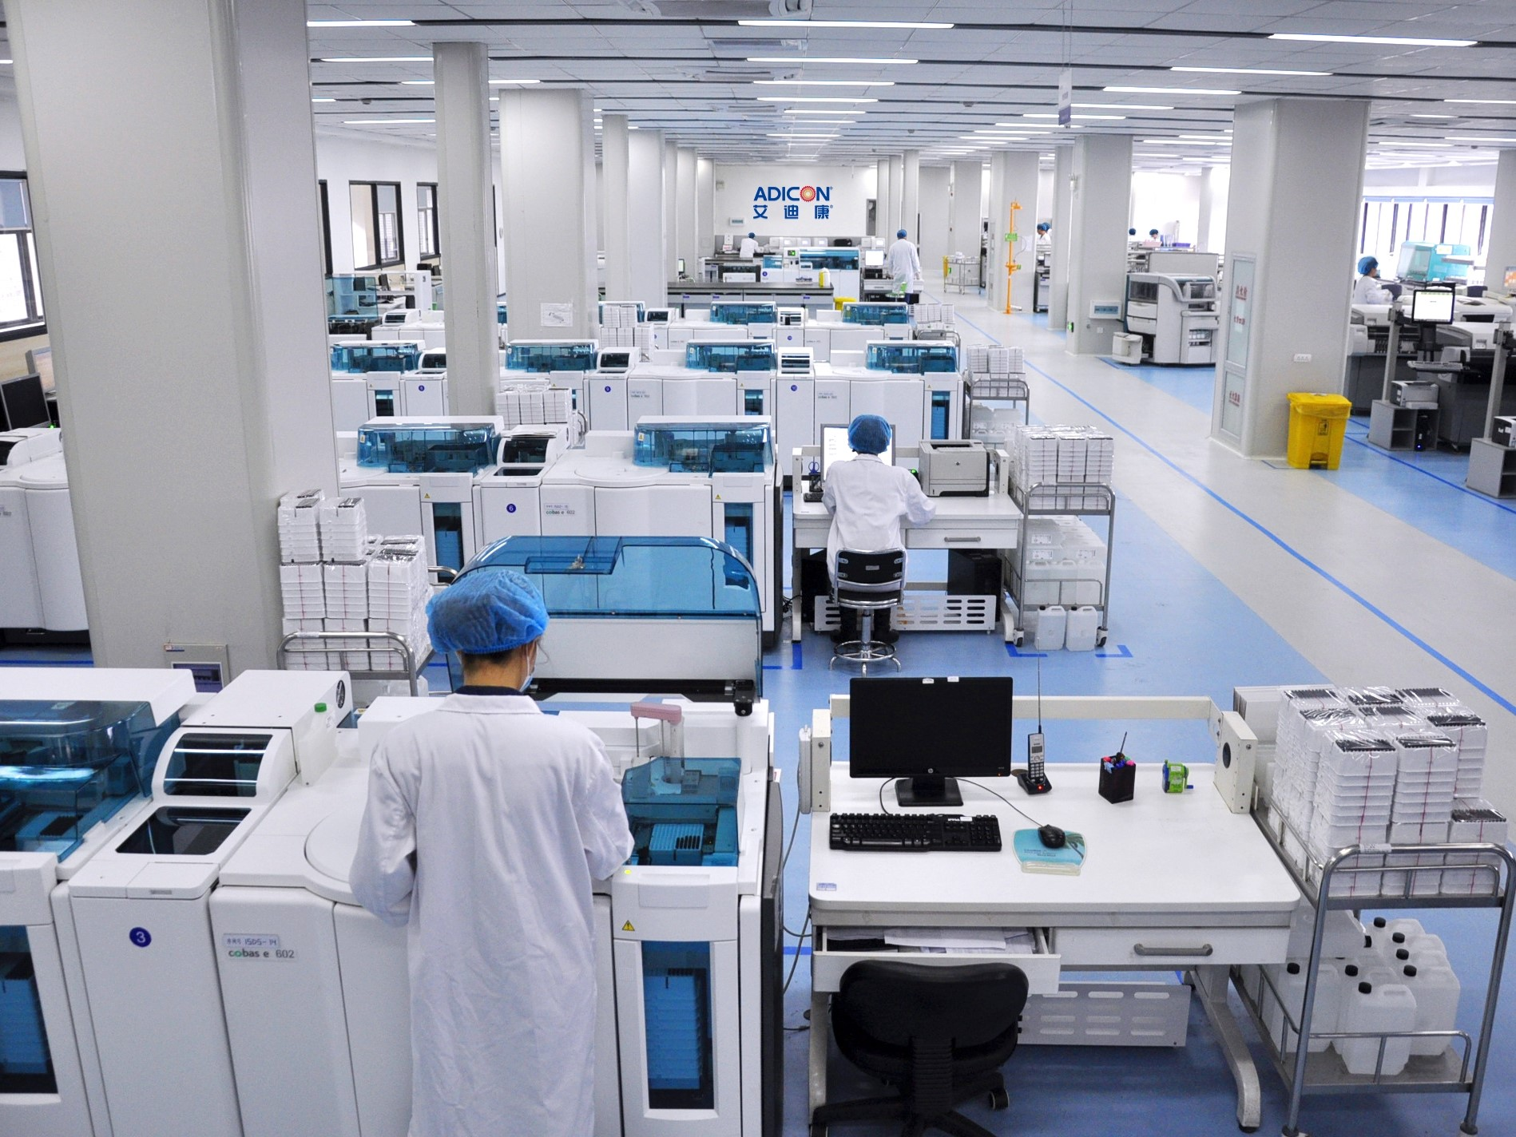
Company Overview

Slide 4








Strong Financial Performance since 2019
2006 - 2011
2019
2023
Geograph-ical Coverage
19-23 Growth Rate
36
~19,000
3.298bn
676mm
355mm
20
~13,000
1.729bn
194mm
73.6mm
Number of labs in China
Number of labs in China
+80.0%
Operating Data
Number of annual customers
+46.2%
Revenue (RMB)
+90.7%
Financial Data
Adjusted EBITDA (RMB)
+248.5%
Adjusted net profit (RMB)
+382.3%
4

Slide 5


Covid Taper Resulting in y-o-y Declines Offset by Strong Base Business Growth
28%
16%
43%
15%
Revenue in 2023 compared to non-covid revenue in 2022
Non-covid revenue in 2023 compared to non-covid revenue in 2022
Growth rate of Esoteric testing in 2023
y-o-y Growth rate of numbers of Secondary and Tertiary institutions customers in 2023
5

Slide 6




Continuous Breakthroughs in Esoteric Testing
1
1
Continuous revenue growth in Esoteric testing in recent years
1
2020-2023 CAGR：39.3%
未来战略
2
Improvement in ASP
driven by Esoteric testing
3
Rapid revenue growth across all Esoteric testing categories
1
1
66%
35%
43%
7%
Infection disease testing increased y-o-y
Oncology testing increased y-o-y
Esoteric testing increased y-o-y
32%
33%
Maternal and pediatric testing increased y-o-y
Hematology testing increased y-o-y
6

Slide 7



Lab Expansion and Technical Serivce Bring Vitality into the Business
Integrated Network
Lab Coverage
36 independently-operated laboratories across China, forming an integrated network
2023
23
Provincial Labs
13
Secondary Labs
30
Province Coverage
未来战略
Fill the gap in provincial market
Technical Service/
Regional Testing Center
Shijiazhuang
64% growth in no. of projects
Upward trend in contract signing
59% growth in business revenue
Focus on high-quality secondary market
Plan of expansion
1 per year
Provincial Lab
1-2 per year
Secondary Lab
2-3 per year
Technical Service/
Regional Testing Center
Shaoxing
Wenzhou (Ouhai)
7

Slide 8












Intelligent Management and Application of Innovative Technology
Strategic collaboration
Six Technology Centers
Artificial Intelligence
Digital Upgrade in 2023
Clinical Testing Center
Telepathology
Hematology Diagnostic Center
DTMS
New LIS system
improving efficiency by 10+ times
Genetic/Chromosome Testing Center
Pathological Diagnosis Center
New Settlement System
Mass Spectrometry Technology Center
Project Assistant App
...
Master data platform
Gene Technology Center
AI-reviewed images in 2023
3 million
Technology Center
Digitalization
AI enhances diagnostic efficiency
Increase investment in automation, robotics, and interconnected devices.
In September 2023, Guardant's product was officially launched in China, and sample testing had begun in December 2023.
8

Slide 9



Industry-leading Operational Capabilities
01
Lean Production Management System
Strong and Flexible Supply Chain
02
Quality Manage-ment
2 new labs have obtained the ISO15189 certificate, bringing the total number of accredited labs to 20, accreditation rate of provincial labs reached 78%
Average number of passing projects reached 94 (as of 2024.01)
The cost advantage of centralized procurement: more than 90% of the group's materials are purchased in a unified manner; on-site procurement is flexible: combined with centralized procurement, it improves timeliness
Purchasing
未来战略
All self-operated logistics networks cover more than 90% of districts and counties across the country, and the self-developed Ai Logistics Information System
2.24
Logistics
43.5%
Gross Margin
10.8%
Adjusted Net Margin
Reagent consump-tion Rate
Manpower Efficiency
Complete intelligent warehouse management: real-time/traceable/paperless/intelligent; forming strategic cooperation with domestic leading IVD company (Jiuzhoutong)
Warehousing
10%
15%
Leading R&D Capabilities
03
ESG
Proper disposal of waste with strict monitoring
Reduce emissions by 1% to 3% annually
Collaborate with the Zhejiang Women and Children's Foundation to launch the "Small Steps, Great Love" charity event, donating 2 million in HPV testing services.
Subsidiaries with High-tech Recognition
R&D Intensity
Number of Patents
+3
16%
9

Slide 10
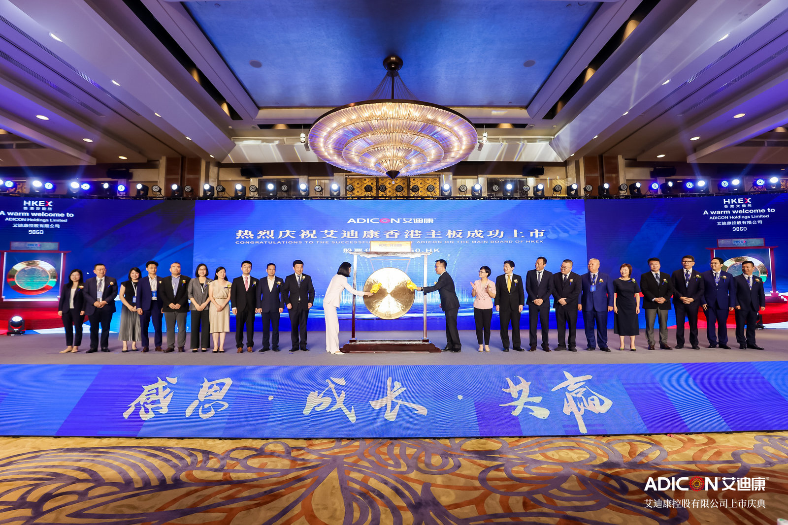













Recognition from Capital Market
Pre-IPO Investors
Cornerstone Investors
Market Recognition
1
2023.09.04
2
2023.09.04
3
4
2024.02.29
10

Slide 11
Financial Highlights

Slide 12
Covid Taper Resulting in y-o-y Declines Offset by Strong Base Business Growth
Total Revenues
Gross Profit
RMB MM
RMB MM
Revenues
yoy Revenue Growth
Gross Profit
Gross Profit Margin
Adjusted EBITDA⁽¹⁾
Adjusted Net Profit⁽²⁾
RMB MM
RMB MM
Adjusted EBITDA
Adjusted EBITDA Margin
Adjusted Net Profit
Adjusted Net Profit Margin
12

Slide 13
Operational efficiency has improved significantly in recent years
Sales Expense
Administrative Expenses ⁽¹⁾
R&D Expenses
RMB MM
RMB MM
RMB MM
13

Slide 14
Historical Improvements in Working Capital Days and Cash Flow Conversion Expected to Normalize after this Transition Year
Inventory Turnover Days⁽¹⁾
Trade Receivables Turnover Days⁽²⁾
Trade Payables Turnover Days⁽⁴⁾
Cash Conversion Ratio⁽⁵⁾
14

Slide 15
Income Statement
 | Year ended 31 December
 | 2018 | 2019 | 2020 | 2021 | 2022 | 2023
REVENUE | 1,530,246 | 1,729,261 | 2,741,731 | 3,379,515 | 4,860,613 | 3,297,828
Cost of sales | (1,064,308) | (1,208,328) | (1,625,071) | (1,937,126) | (2,964,448) | (1,863,721)
Gross profit | 465,938 | 520,933 | 1,116,660 | 1,442,389 | 1,896,165 | 1,434,107
Other income and gains | 4,570 | 3,421 | 12,686 | 14,763 | 50,811 | 61,609
Selling and marketing expenses | (220,720) | (208,216) | (359,051) | (489,783) | (553,272) | (485,155)
Administrative expenses | (123,980) | (116,966) | (236,566) | (263,003) | (282,262) | (271,015)
Research and development costs | (72,959) | (69,932) | (102,009) | (125,446) | (162,746) | (143,522)
Other expenses | (23,485) | (24,260) | (37,712) | (48,530) | (128,440) | (99,622)
Listing expense | - | - | (16,179) | (35,290) | (9,664) | (72,189)
Finance costs | (13,083) | (17,382) | (19,644) | (16,326) | (76,824) | (86,316)
Fair value loss on financial liabilities at FVTPL | - | - | - | (61,531) | 87,044 | 11,475
PROFIT BEFORE TAX | 16,281 | 87,598 | 358,185 | 417,243 | 820,812 | 349,372
Income tax expense | (14,007) | (17,155) | (68,732) | (94,948) | (135,928) | (87,050)
PROFIT FOR THE YEAR | 2,274 | 70,443 | 289,453 | 322,295 | 684,884 | 262,322
Attributable to:
Owners of the parent | 863 | 67,906 | 284,121 | 315,540 | 680,793 | 234,885
Non-controlling interests | 1,411 | 2,537 | 5,332 | 6,755 | 4,091 | 27,437
15

Slide 16
Adjusted EBITDA – non-IFRS reconciliation
 | Year ended 31 December
 | 2018 | 2019 | 2020 | 2021 | 2022 | 2023
PROFIT BEFORE TAX | 16,281 | 87,598 | 358,185 | 417,243 | 820,812 | 349,372
(+) Depreciation | 76,598 | 85,736 | 113,118 | 136,235 | 188,565 | 158,949
(+) Amortization | 580 | 610 | 662 | 1,617 | 4,853 | 8,490
(+) Finance costs | 13,083 | 17,382 | 19,644 | 16,326 | 76,824 | 86,316
(-) Bank interest income | 767 | 889 | 3,765 | 6,289 | 8,874 | 20,160
EBITDA | 105,775 | 190,437 | 487,844 | 565,132 | 1,082,180 | 582,967
(+) Share based compensation expenses | - | 2,735 | 63,598 | 37,325 | 15,049 | 17,054
(+) Listing expenses | - | - | 16,179 | 35,290 | 9,664 | 72,189
(+) FV loss/(gain) on financial instruments at FVTPL | - | - | - | 61,531 | (87,044) | (11,475)
(+) FV gains on contingent consideration | - | - | - | - | (13,337) | -
(+) FV gains on put option over non-controlling interests | - | - | - | - | - | (15,305)
(+) FV losses/(gains) on derivative financial instruments | - | - | - | - | (7,826) | 6,165
(+) Foreign exchange (gains)/losses, net | 925 | 434 | (1,427) | 50 | 6,743 | 8,198
(+) Covid-19 related inventory impairment | - | - | - | - | 1,421 | 15,976
ADJUSTED EBITDA | 106,700 | 193,606 | 566,194 | 699,328 | 1,006,850 | 675,769
yoy growth |  | 81.4% | 192.4% | 23.5% | 44.0% | (32.9%)
Adjusted EBITDA margin | 7.0% | 11.2% | 20.7% | 20.7% | 20.7% | 20.5%
16

Slide 17
Adjusted Net Income – non-IFRS reconciliation
 | Year ended 31 December
 | 2018 | 2019 | 2020 | 2021 | 2022 | 2023
PROFIT FOR THE YEAR | 2,274 | 70,443 | 289,453 | 322,295 | 684,884 | 262,322
(+) Share based compensation expenses | - | 2,735 | 63,598 | 37,325 | 15,049 | 17,054
(+) Listing expenses | - | - | 13,984 | 30,087 | 8,204 | 72,099
(+) FV loss/(gain) on financial instruments at FVTPL | - | - | - | 61,531 | (87,044) | (11,475)
(+) FV gains on contingent consideration | - | - | - | - | (13,337) | -
(+) FV gains on put option over non-controlling interests | - | - | - | - | - | (15,305)
(+) FV losses/(gains) on derivative financial instruments | - | - | - | - | (7,826) | 6,165
(+) Foreign exchange (gains)/losses, net | 925 | 434 | (1,427) | 50 | 6,743 | 8,198
(+) Covid-19 related Inventory Impairment | - | - | - | - | 1,421 | 15,976
ADJUSTED NET INCOME | 3,199 | 73,612 | 365,608 | 451,288 | 608,094 | 355,034
yoy growth |  | 2201.1% | 396.7% | 23.4% | 34.7% | (41.6%)
Adjusted Net Income margin | 0.2% | 4.3% | 13.3% | 13.4% | 12.5% | 10.8%
17

Slide 18
Balance Sheet
 | As of 31 December
RMB '000 | 2019 | 2020 | 2021 | 2022 | 2023
NON-CURRENT ASSETS
Property and equipment | 130,154 | 168,579 | 266,137 | 375,428 | 410,987
Right-of-use assets | 194,412 | 155,458 | 173,381 | 218,853 | 187,390
Deferred tax assets | 38,167 | 51,982 | 74,560 | 118,403 | 103,971
Other intangible assets | 3,083 | 3,011 | 20,504 | 143,709 | 151,416
Prepayments, deposits and other receivables | 5,700 | 7,747 | 9,645 | 12,839 | 12,575
Amounts due from related parties | 1,745 | 1,852 | 1,816 | 2,123 | 2,474
Goodwill | - | - | 25,691 | 79,802 | 79,802
Financial assets at fair value through profit or loss | - | - | - | 8,104 | 1,535
Pledged deposits | - | - | - | - | 300,000
Total non-current assets | 373,261 | 388,629 | 571,734 | 959,261 | 1,250,150
CURRENT ASSETS
Inventories | 80,664 | 102,932 | 109,395 | 229,413 | 176,593
Trade and bills receivables | 686,688 | 942,041 | 1,213,512 | 1,856,847 | 1,515,434
Financial assets at fair value | - | - | - | - | 50,837
Prepayments, deposits and other receivables | 34,024 | 61,120 | 105,716 | 127,860 | 188,474
Amounts due from related parties | 4,575 | 199 | 270 | 227 | 25
Cash and bank balances | 304,523 | 1,228,620 | 1,109,211 | 1,680,625 | 959,423
Pledged deposits | - | - | - | - | 412,602
Total current assets | 1,110,474 | 2,334,912 | 2,538,104 | 3,894,972 | 3,303,388
CURRENT LIABILITIES
Trade payables | 261,281 | 383,034 | 510,691 | 1,062,452 | 742,108
Other payables and accruals | 185,657 | 365,428 | 689,136 | 985,104 | 755,527
Contract liabilities | 3,951 | 11,665 | 20,683 | 21,060 | 34,664
 | As of 31 December
RMB ’000 | 2019 | 2020 | 2021 | 2022 | 2023
Interest-bearing bank borrowings | 80,000 | 120,178 | 49,141 | 112,792 | 95,870
Profit tax payable | 8,435 | 44,078 | 50,303 | 124,553 | 77,790
Amounts due to related parties | 147,827 | 55,171 | 36,167 | 61,071 | 1,858
Lease liabilities | 35,403 | 28,416 | 31,653 | 51,400 | 49,201
Total current liabilities | 722,554 | 1,008,970 | 1,387,774 | 2,418,432 | 1,757,018
NET CURRENT ASSETS | 387,920 | 1,325,942 | 1,150,330 | 1,476,540 | 1,546,370
TOTAL ASSETS LESS CURRENT LIABILITIES | 761,181 | 1,714,571 | 1,722,064 | 2,435,801 | 2,796,520
NON-CURRENT LIABILITIES
Interest-bearing bank borrowings | – | 100,276 | 90,790 | 1,023,329 | 791,647
Lease liabilities | 162,957 | 129,710 | 146,297 | 182,455 | 153,117
Deferred tax liabilities | 1,602 | 1,536 | 10,260 | 28,502 | 23,166
Convertible preferred shares | – | 443,931 | 621,870 | 589,179 | -
Total non-current liabilities | 164,559 | 675,453 | 869,217 | 1,823,465 | 967,930
NET ASSETS | 596,622 | 1,039,118 | 852,847 | 612,336 | 1,828,590
EQUITY
Equity attributable to owners of the parent
Share capital | 76 | 77 | 86 | 86 | 97
Reserves | 575,578 | 1,024,262 | 804,155 | 510,738 | 1,707,974
Non-controlling interests | 20,968 | 14,779 | 48,606 | 101,512 | 120,519
Total equity | 596,622 | 1,039,118 | 852,847 | 612,336 | 1,828,590
Total Cash (incl pledged deposits) | 304,523 | 1,228,620 | 1,109,211 | 1,680,625 | 1,672,025
Net Cash (incl pledged deposits) | 224,523 | 1,008,166 | 969,280 | 544,504 | 784,508
18

Slide 19
THANK YOU

